Slide 1
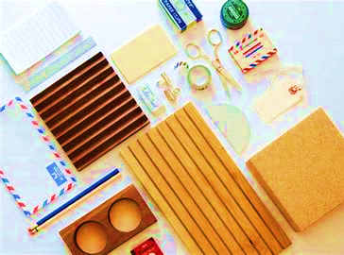
Project TITLE Gents parlor management system
COURSE NAME: SOFTWARE REQUIREMENT ENGINEERING

Slide 2
Group Members Info
Serial no | Members Name | Members Id
31 | MEHEDI HASAN EMON
14 | KAZI AHSANUL HAQUE SHOJIB
30 | RIFAT AHMED
17 | MD REDOY SHEIKH
07 | UMME HABIBA NAZRIN

Slide 3

Table of Content
Introduction
Problem Statement
UML Design
Findings and Challenges
Conclusion
Future enhancements
UI Designs & Specifications [Both Mobile and Computer view]

Slide 4
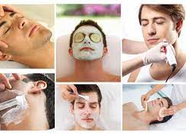
Introduction
The topic of our project is Gents parlor management system. Gents' parlor is a place where various services are provided related to hair and skin health, they can be hair cutting and styling, and skin treatments of various kinds according to the demand of the customer. Gents' parlor management handling all the elements and activities related to hair and beauty salon and providing essential services is known as Gents parlor management.

Slide 5
Problem STATEMENT
We want to introduce our gents’ parlor management system under the name “Ummah’s People” gents parlor management system.
This project is all about the Smart Gents parlor management system.
It fulfills all the demands of customers and the time schedule of the parlor
The target of this project is to understand each element of Gents parlor and understand how factors that affect the environment are managed.
Advantages of our mobile appilication and website

Slide 6

UML DIAGRAM

Slide 7
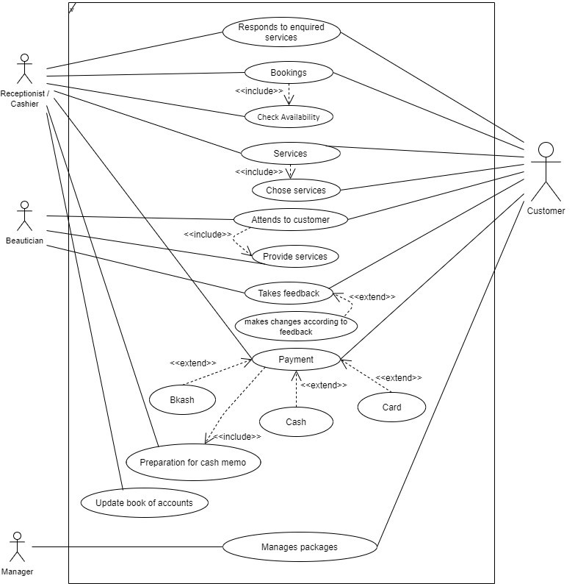
Use case diagram

Slide 8
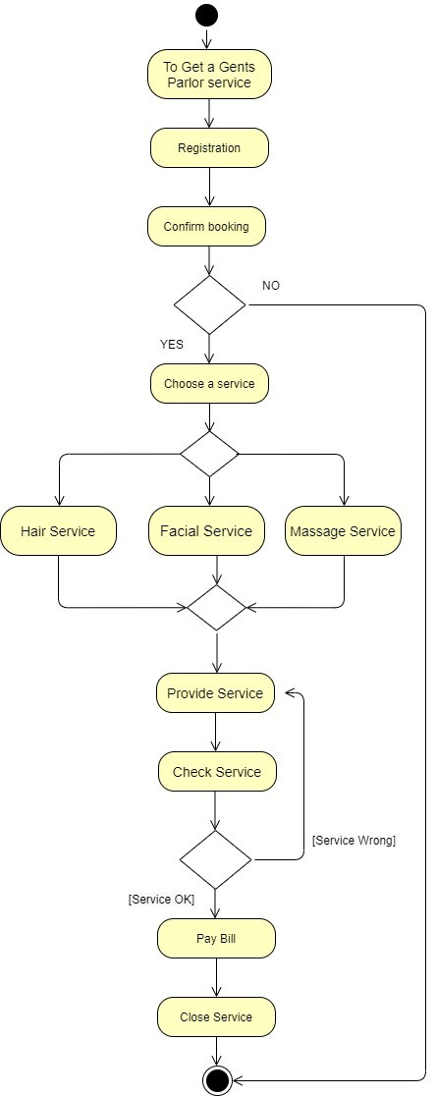
Activity diagrams

Slide 9
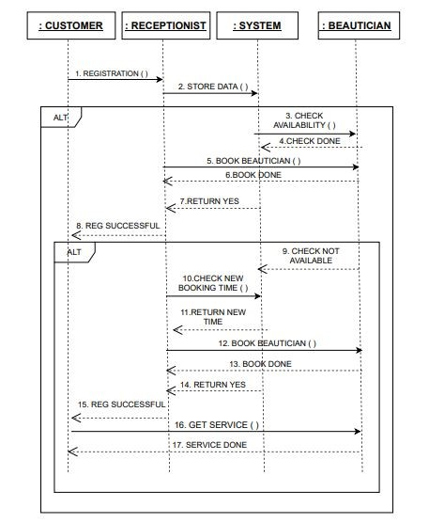
Sequence diagram

Slide 10
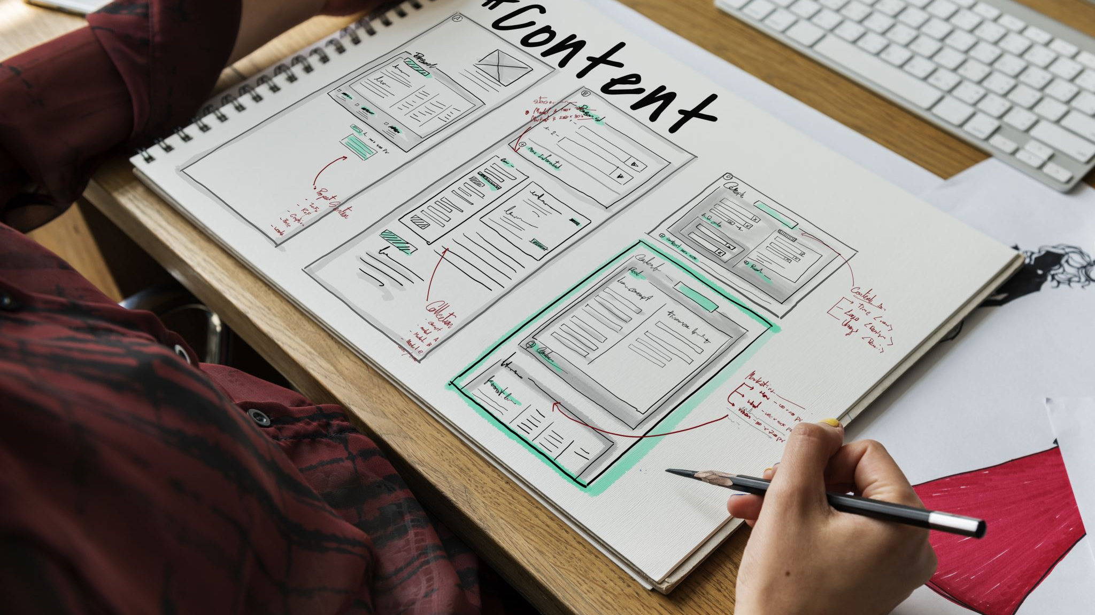
UI DESIGN AND SPECIFICATION

Slide 11
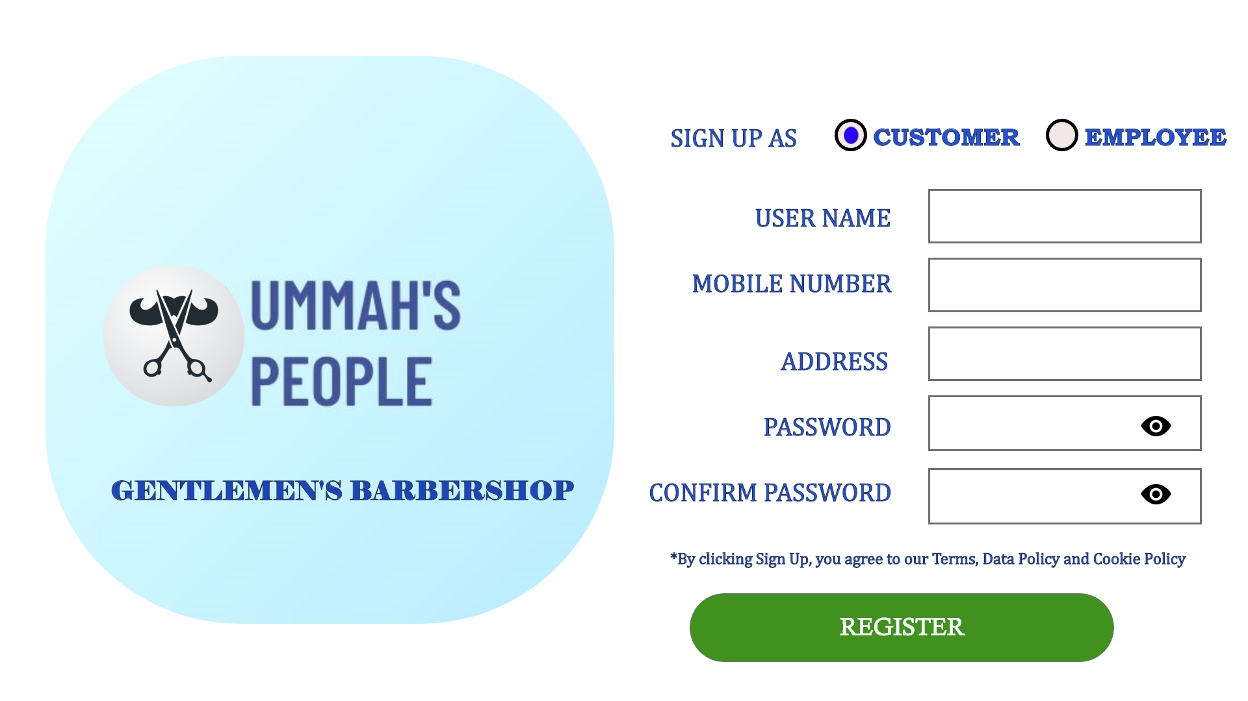
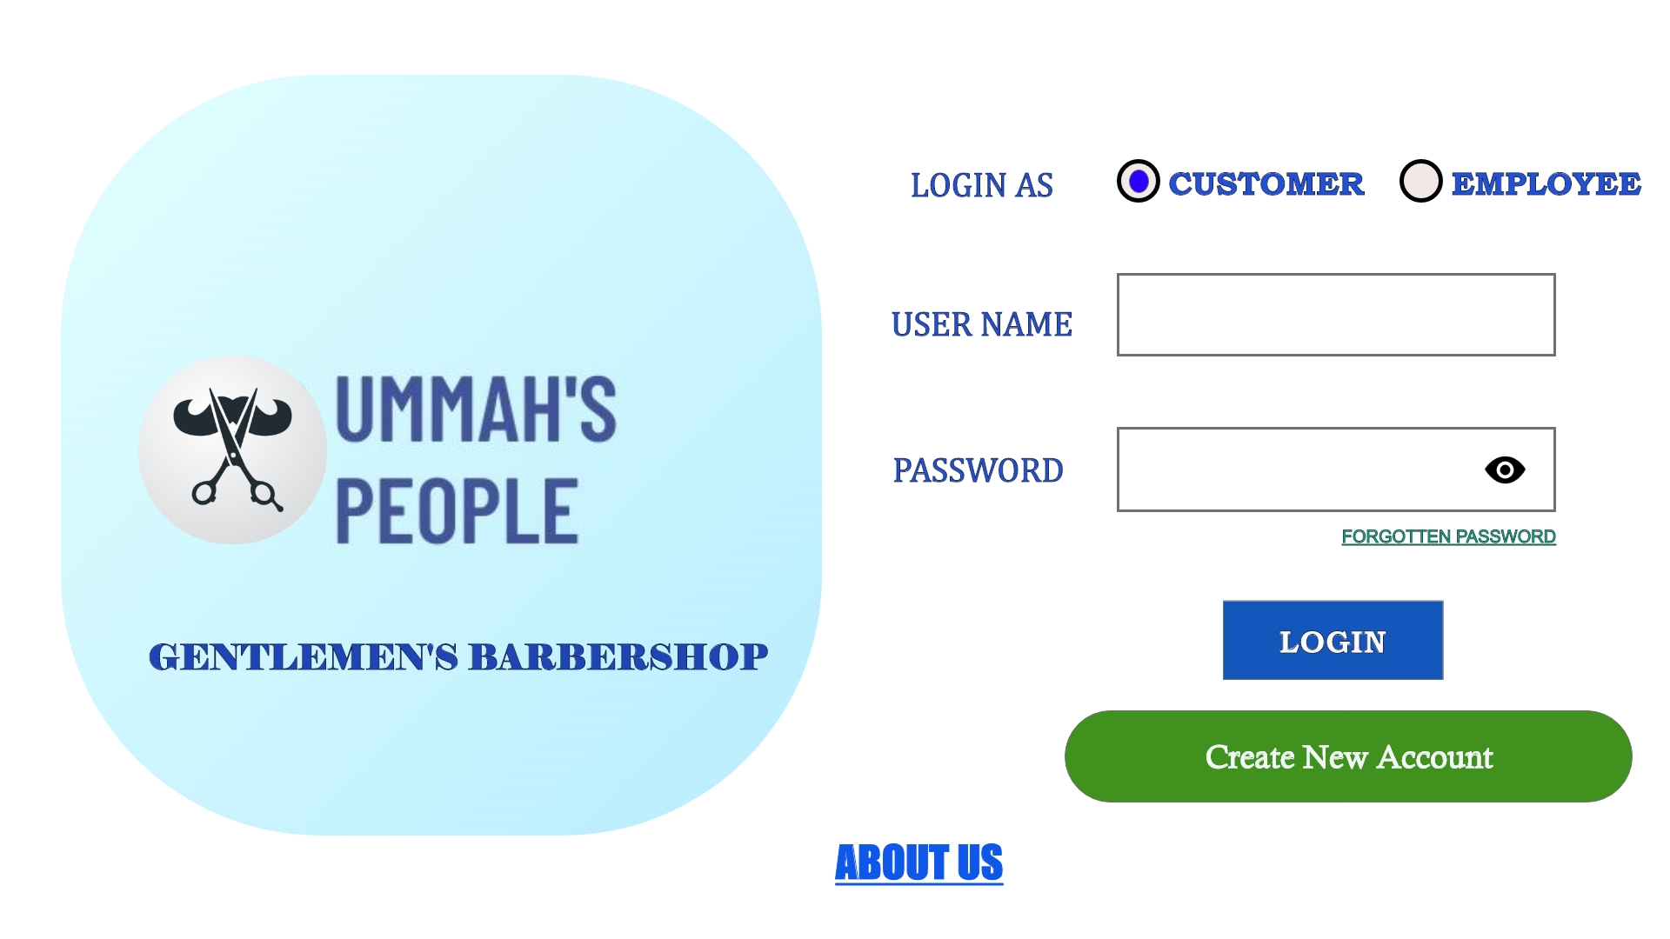
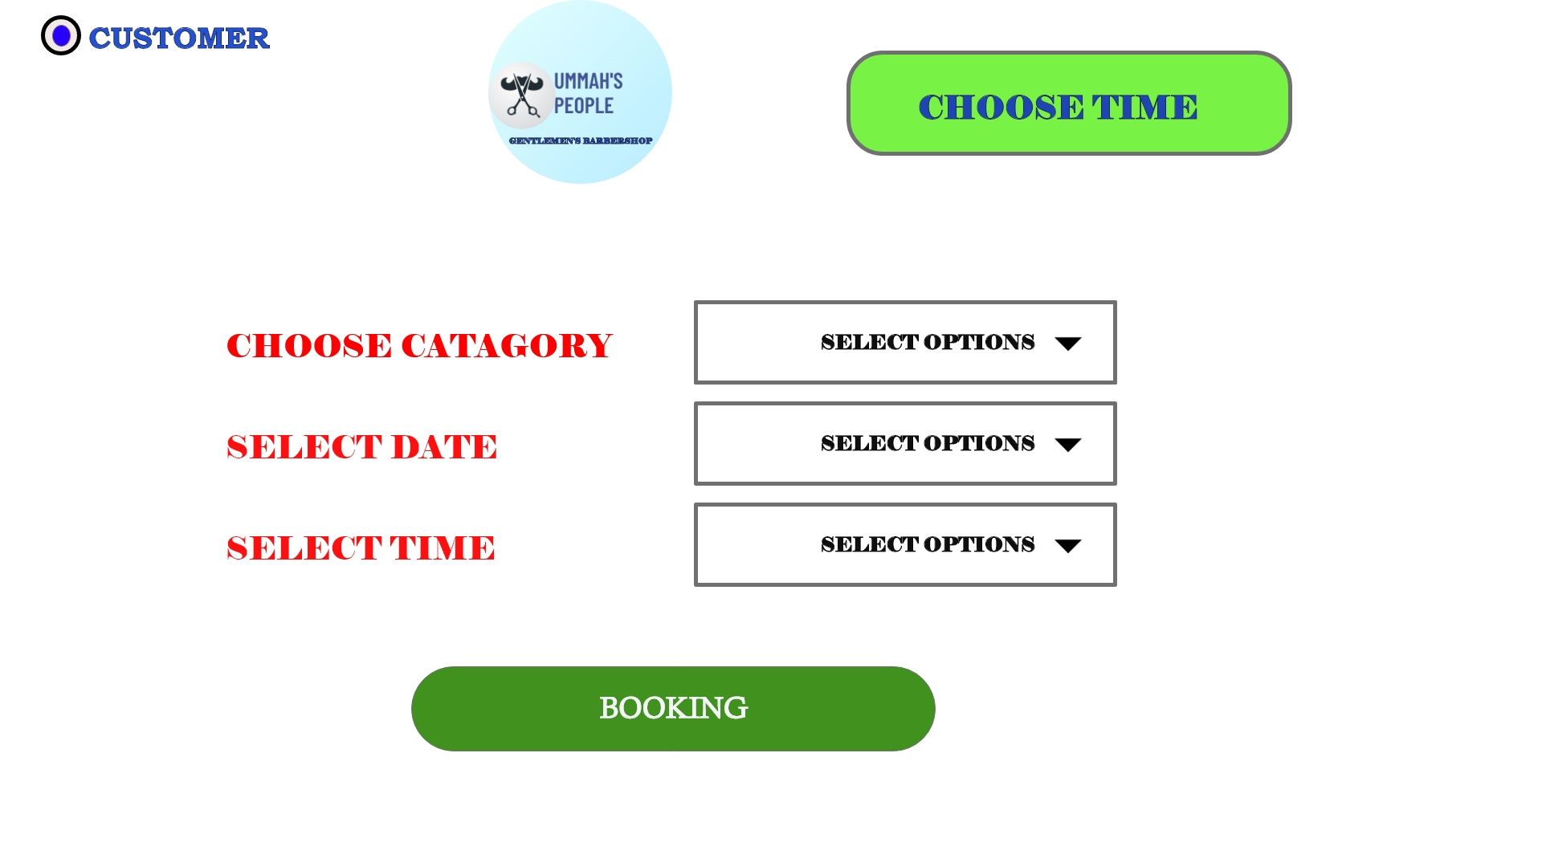
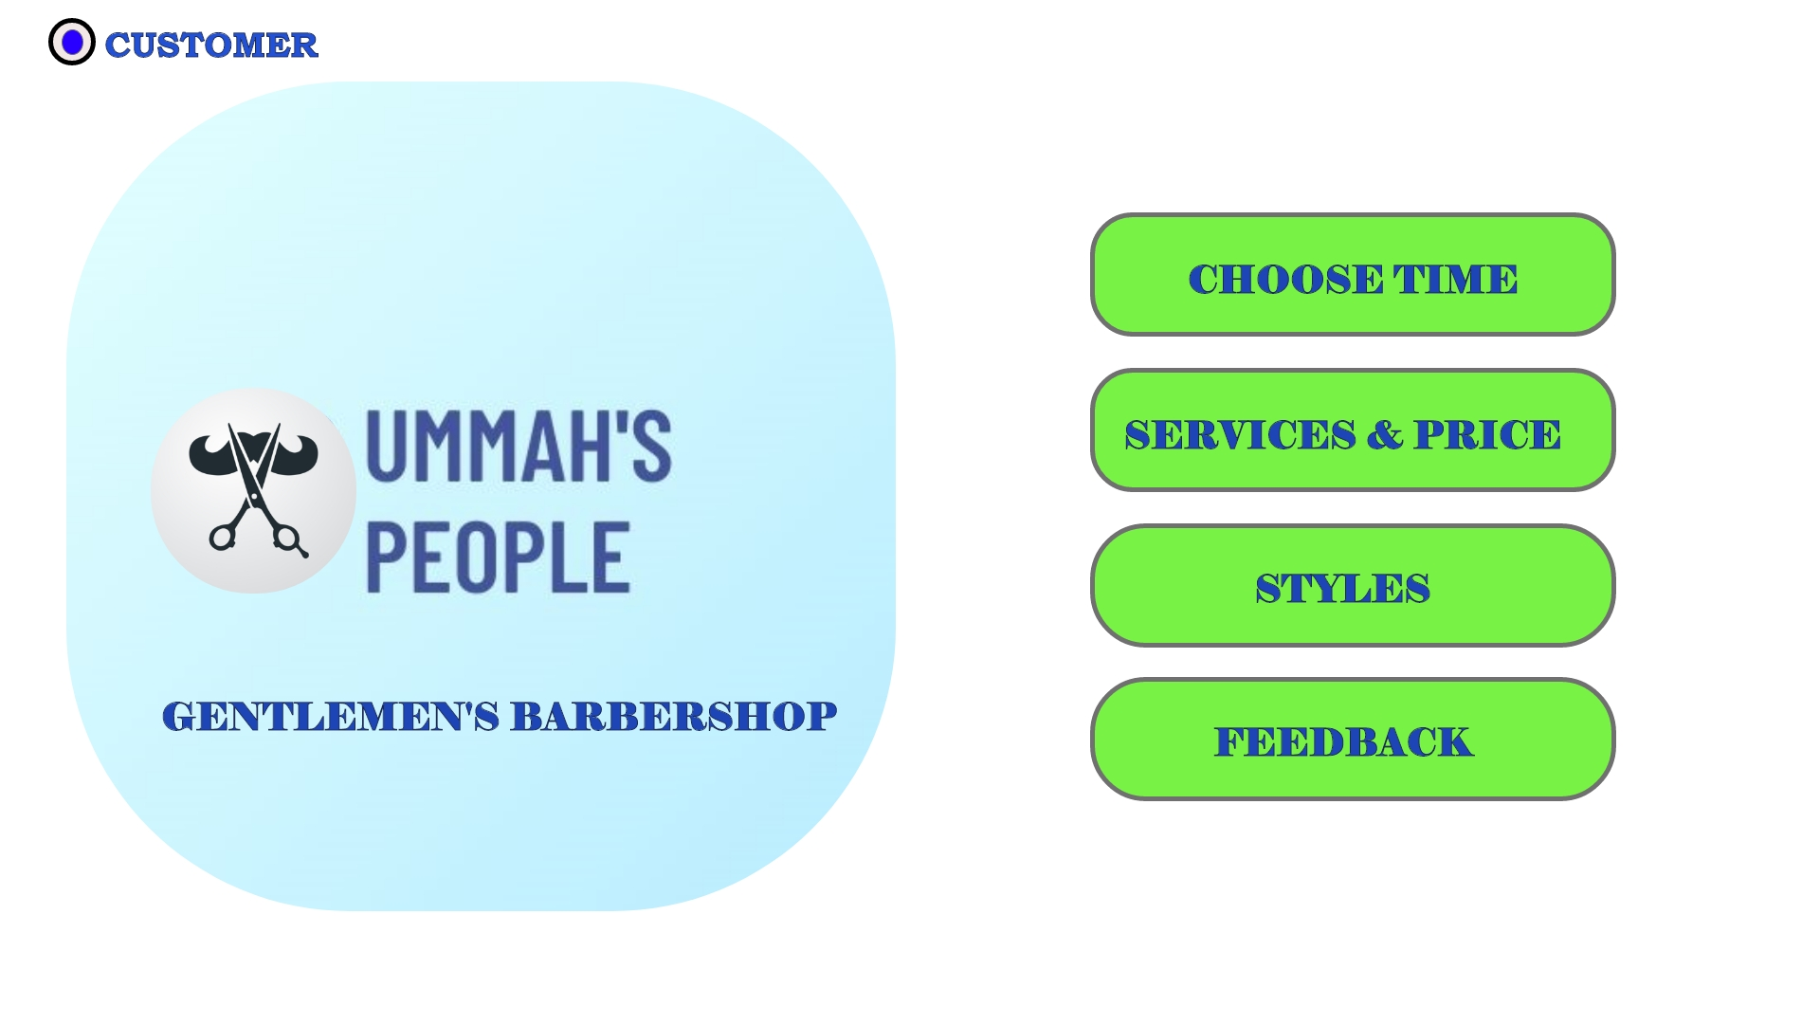
UI Designs & Specifications
Website and software View in our project:

Slide 12
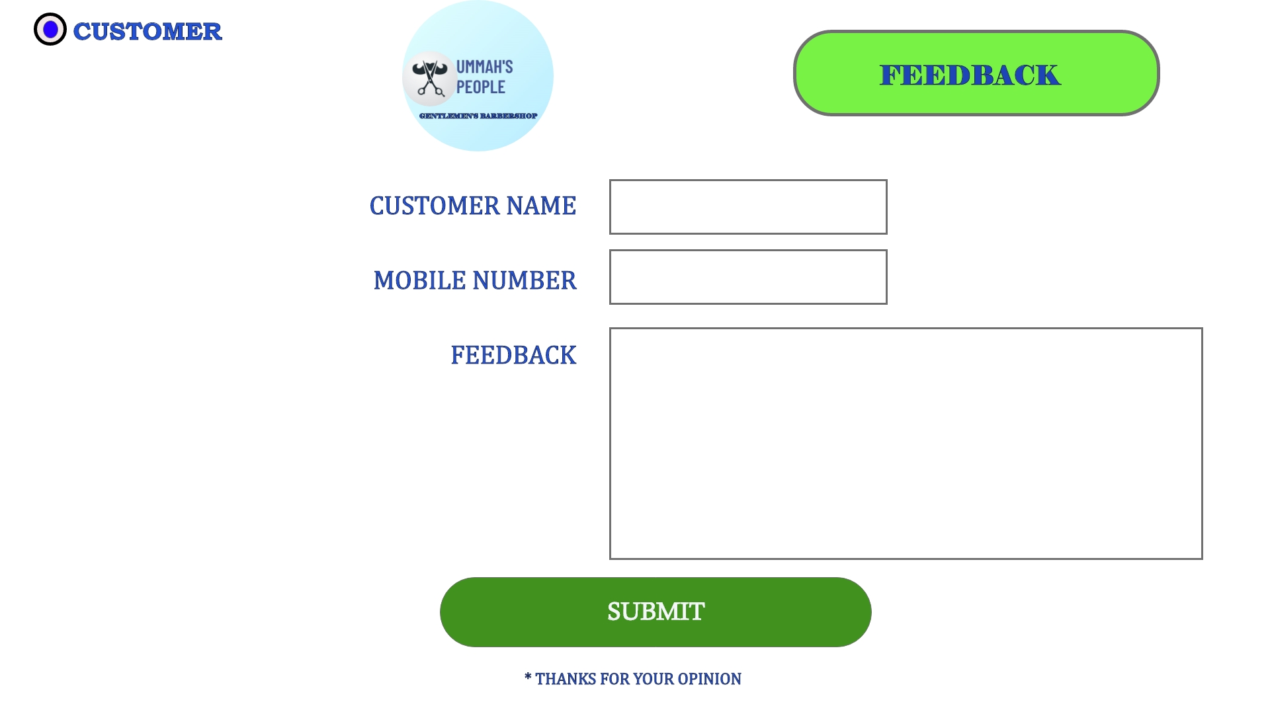
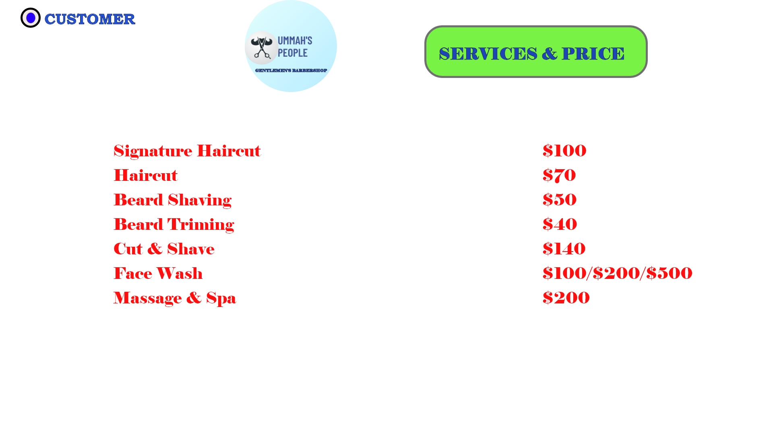
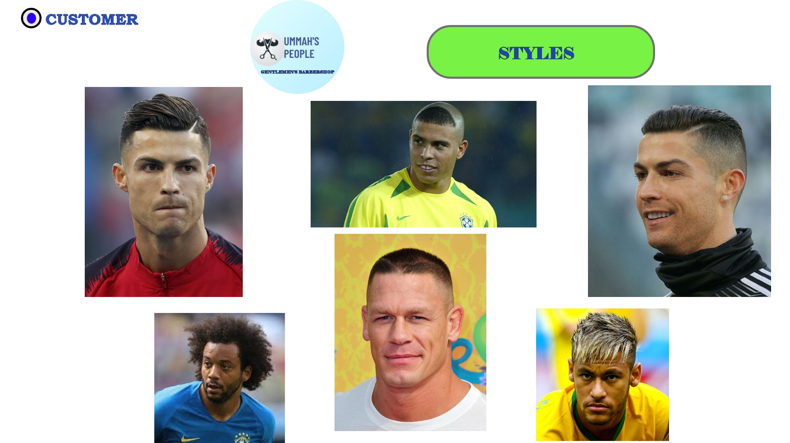
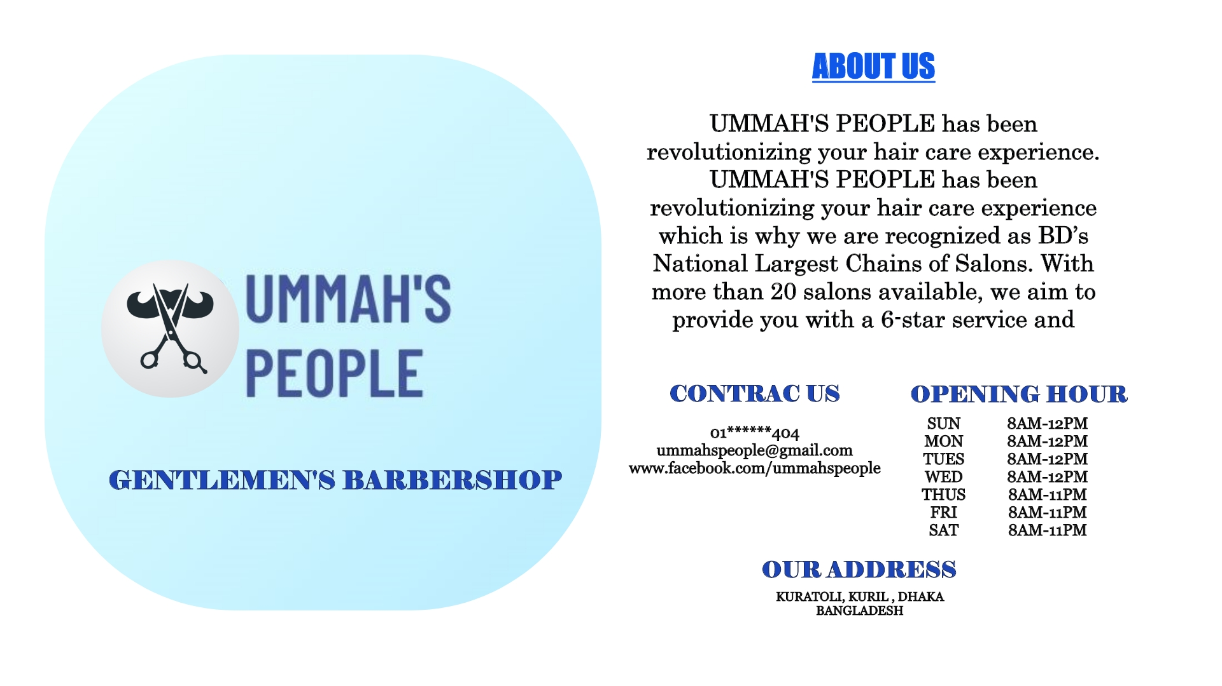
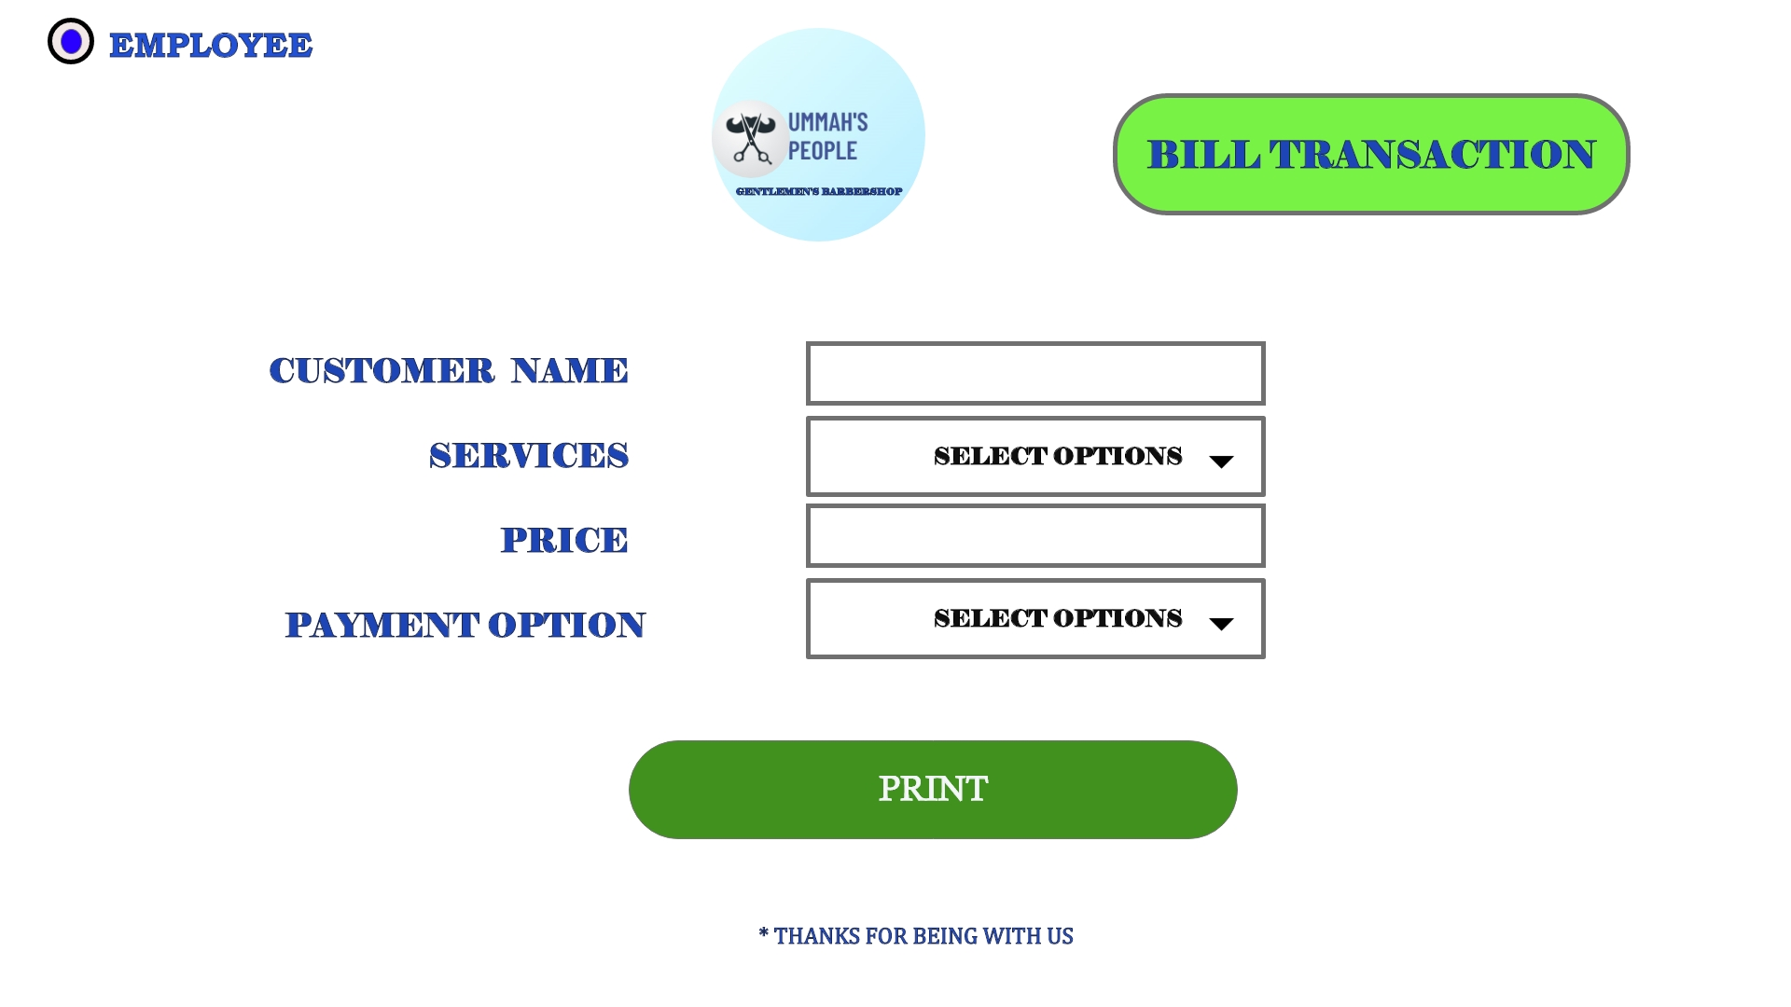
Website and software View in our project:

Slide 13
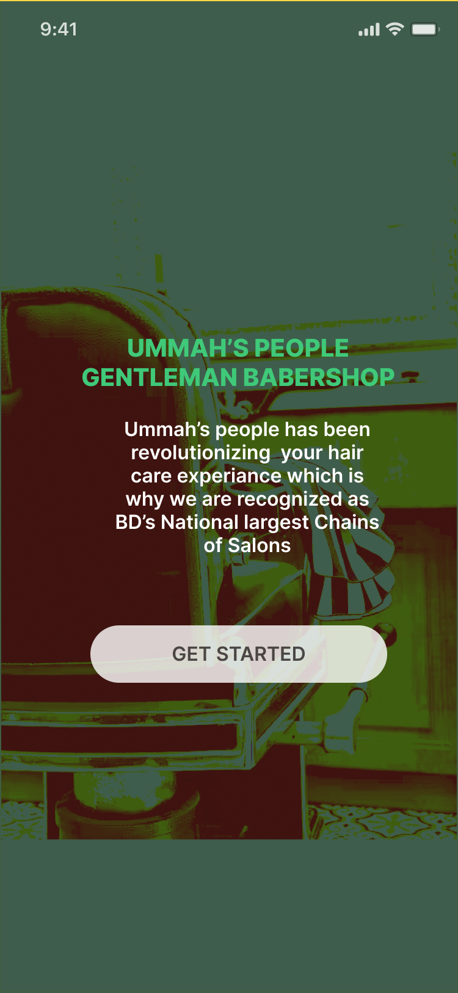
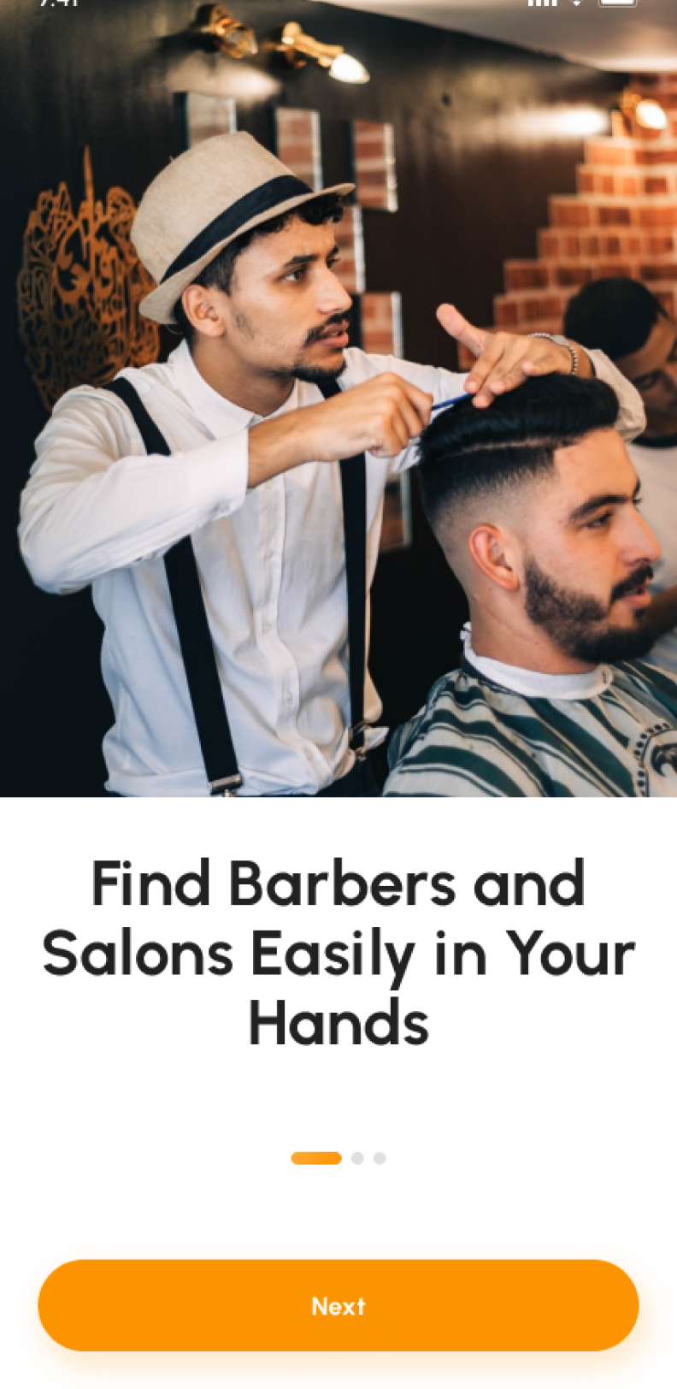
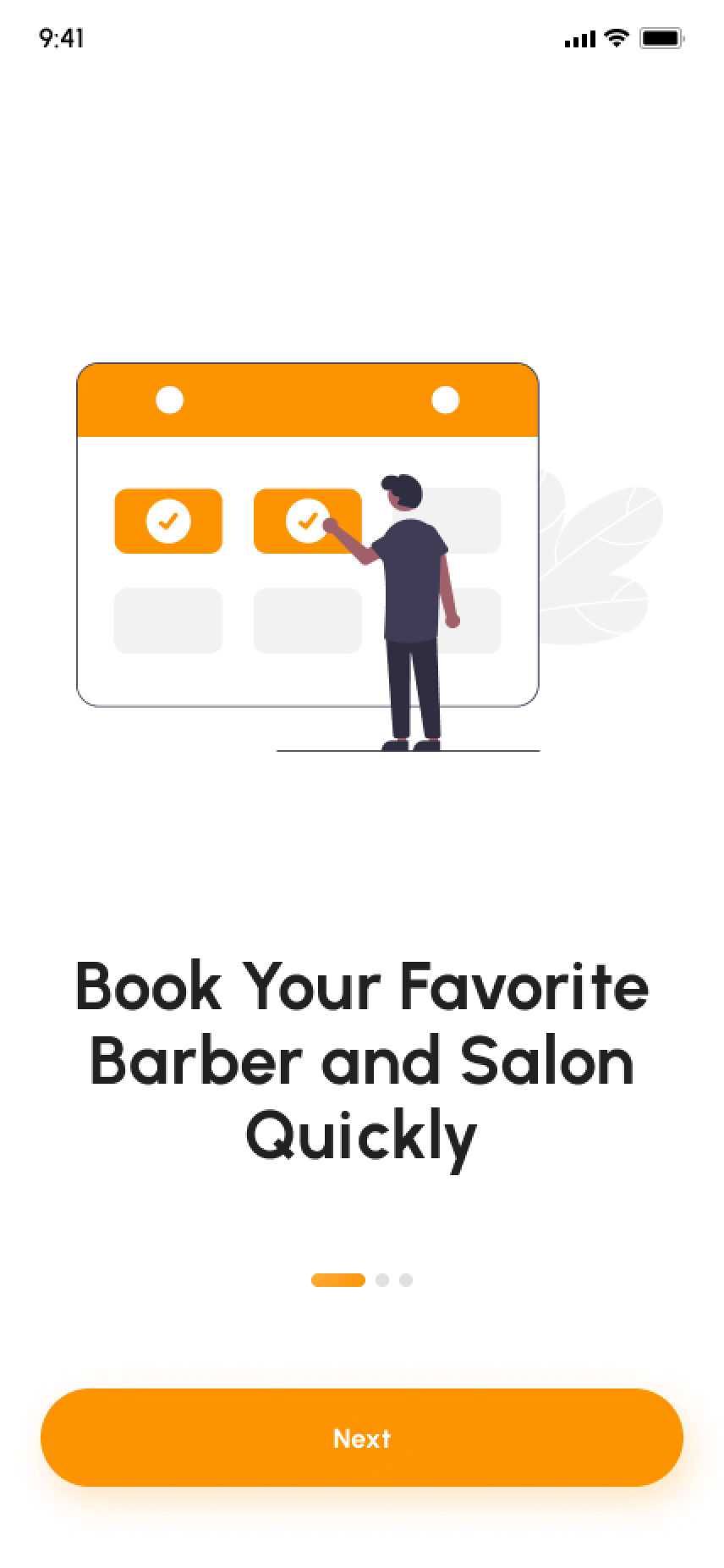
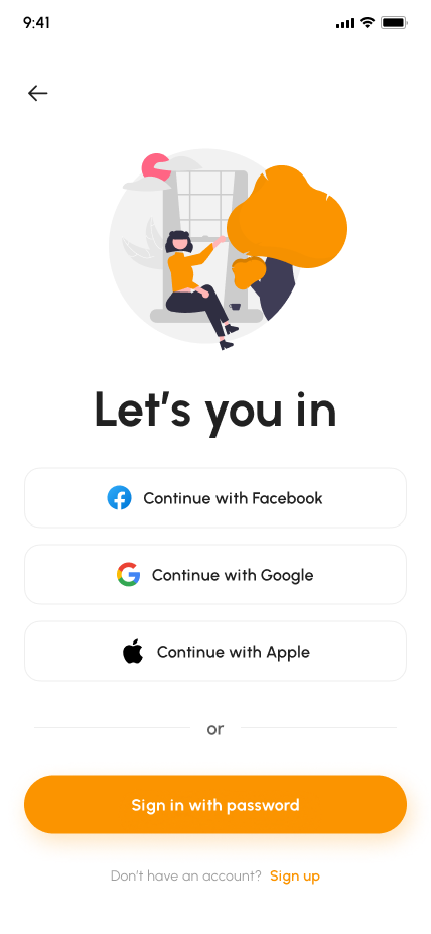
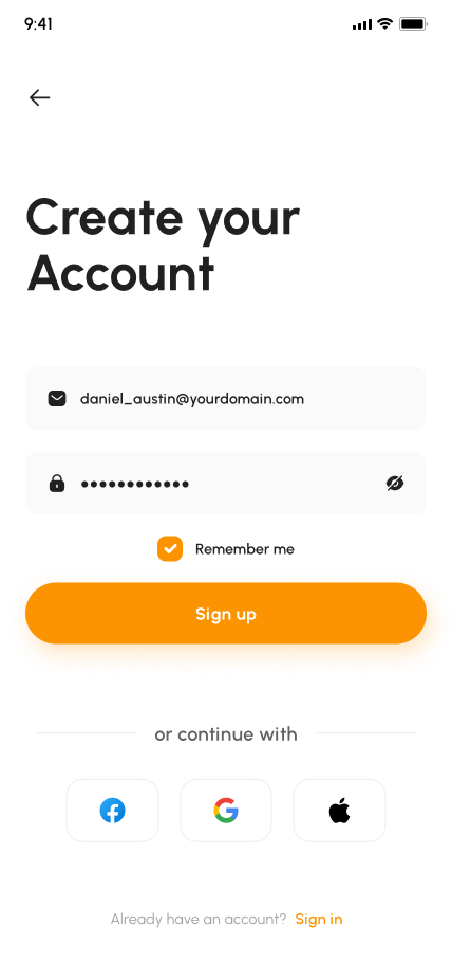
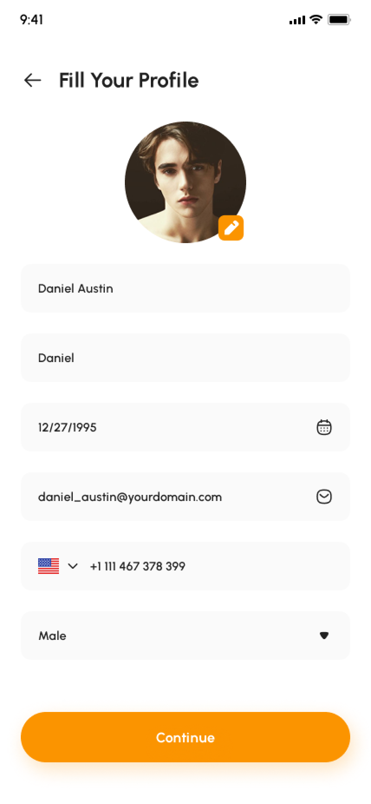
UI DESIGN OF MOBILE APPLICATION
Homepage
Account Creation

Slide 14
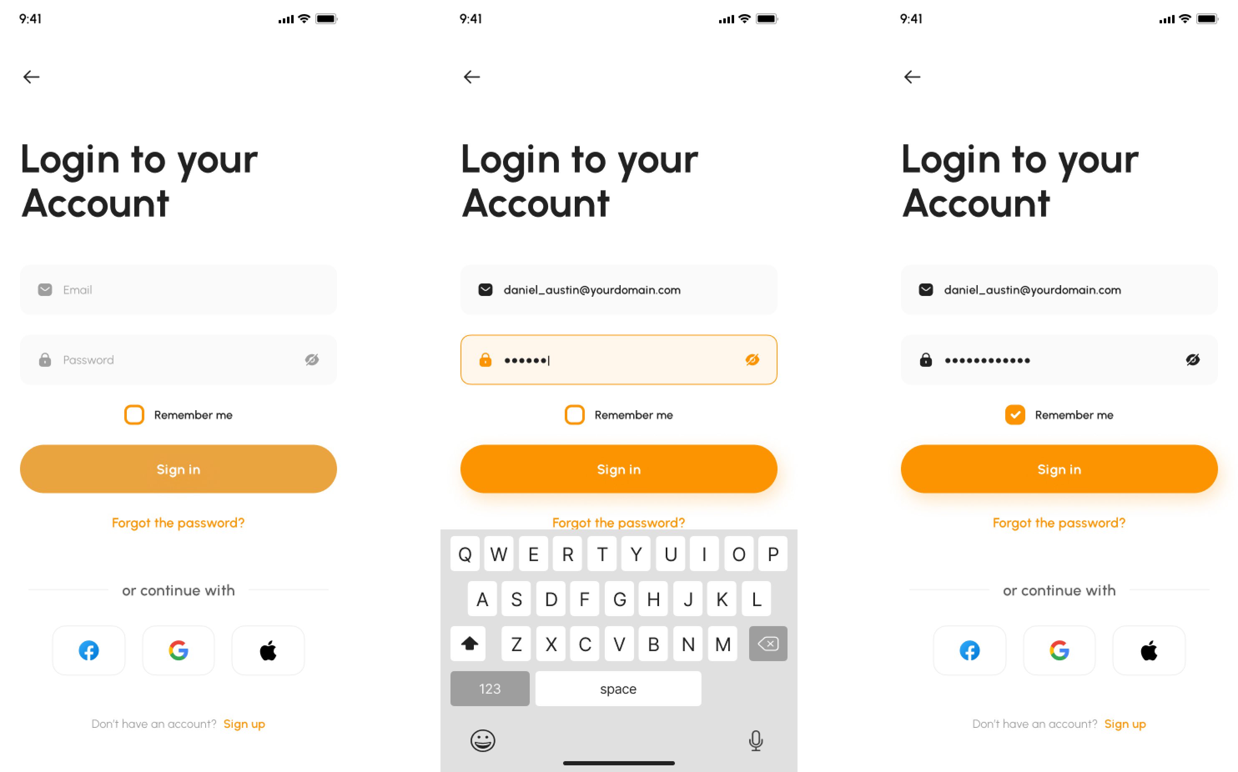
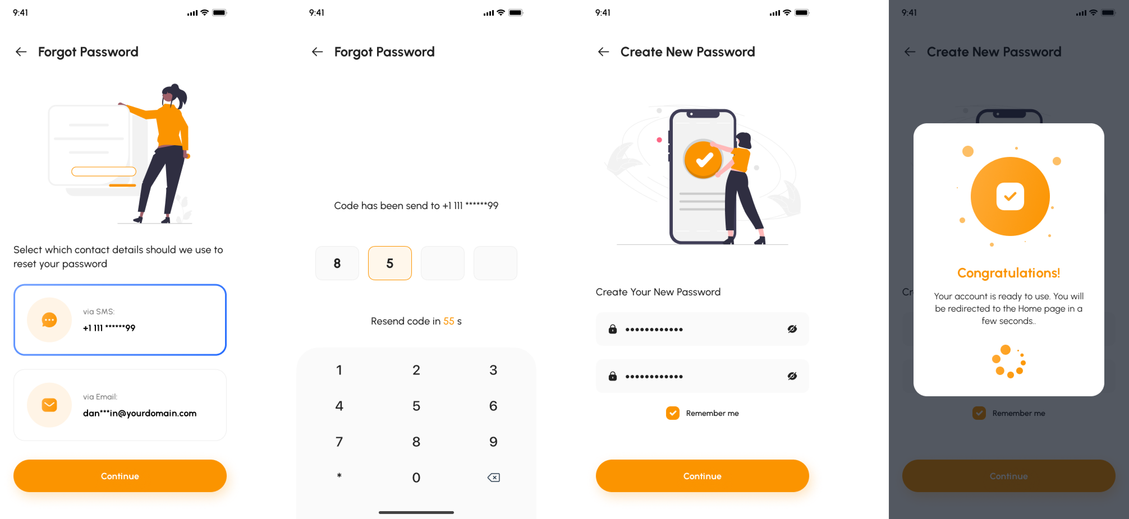
UI DESIGN OF MOBILE APPLICATION
Login UI design
Forget Password

Slide 15
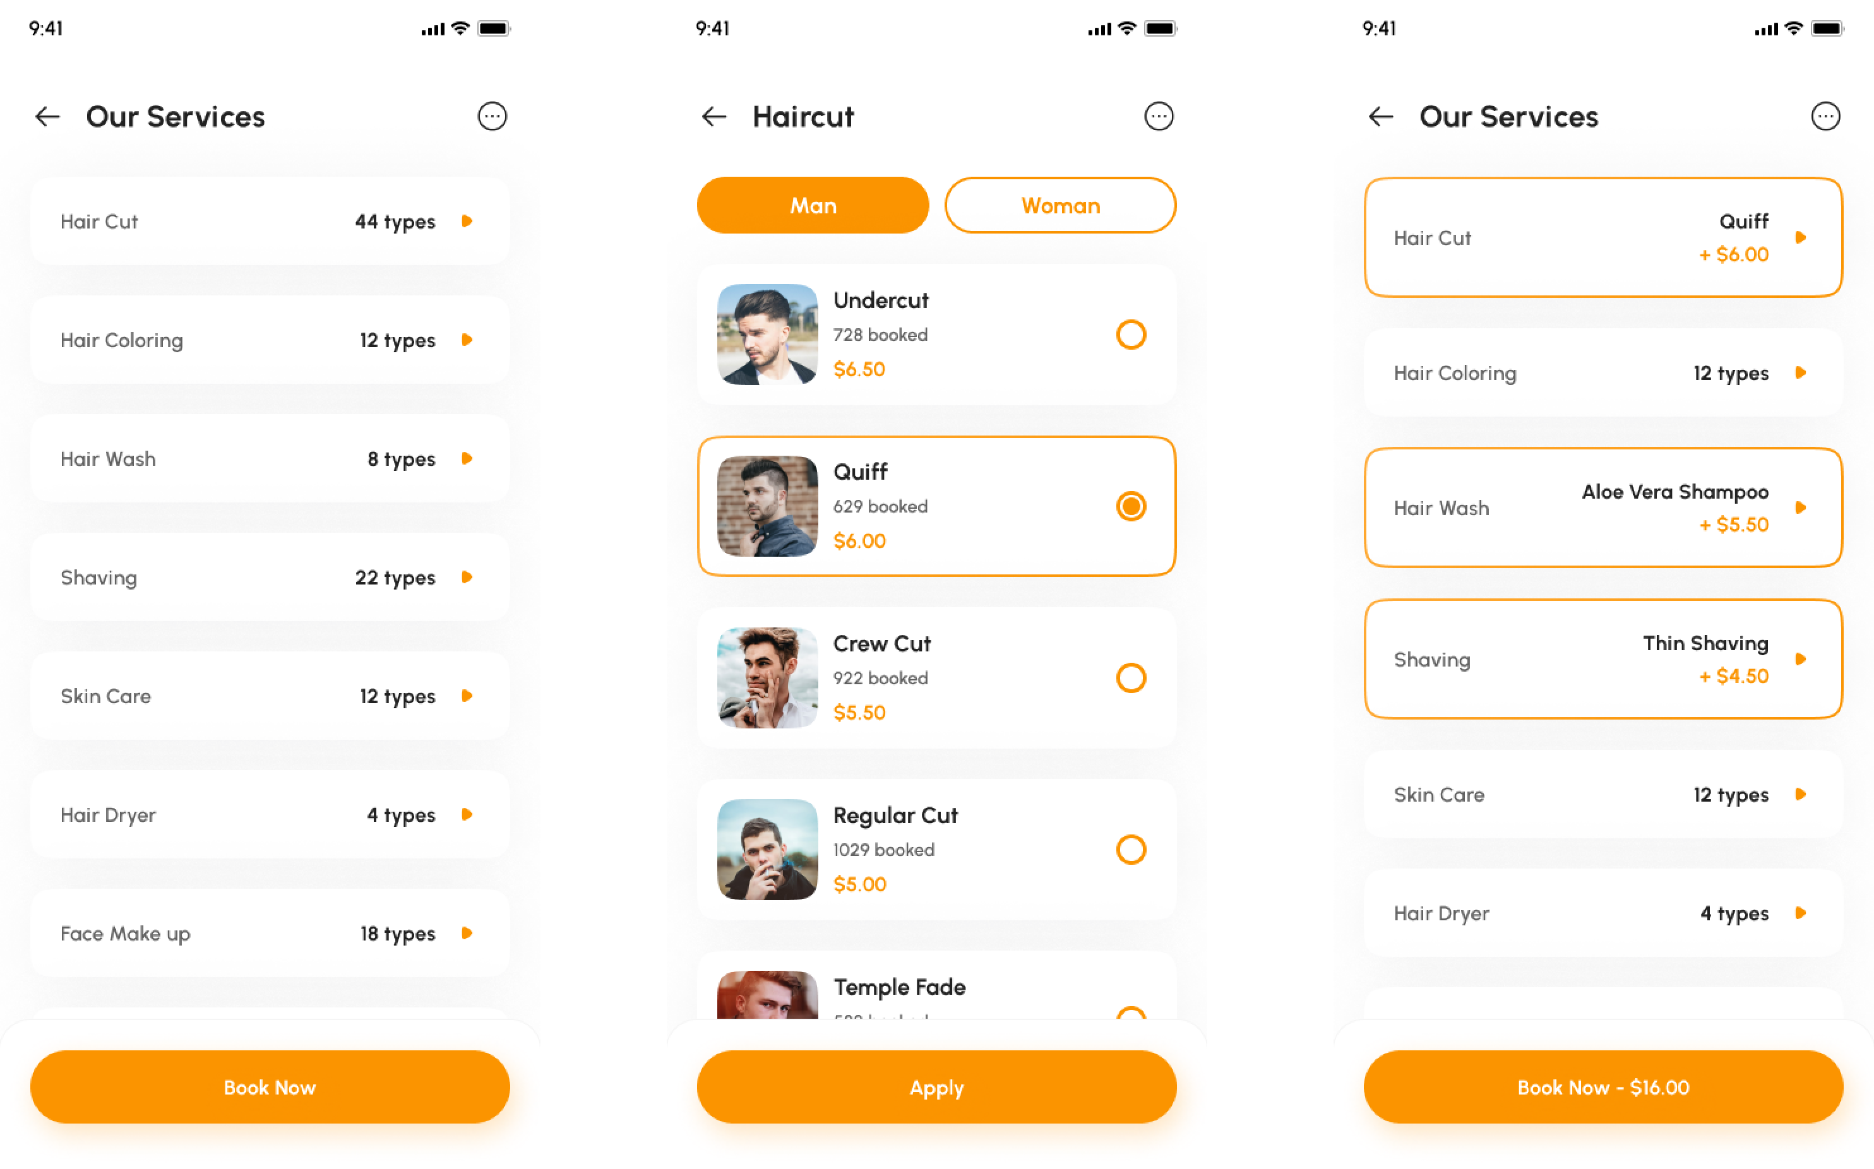
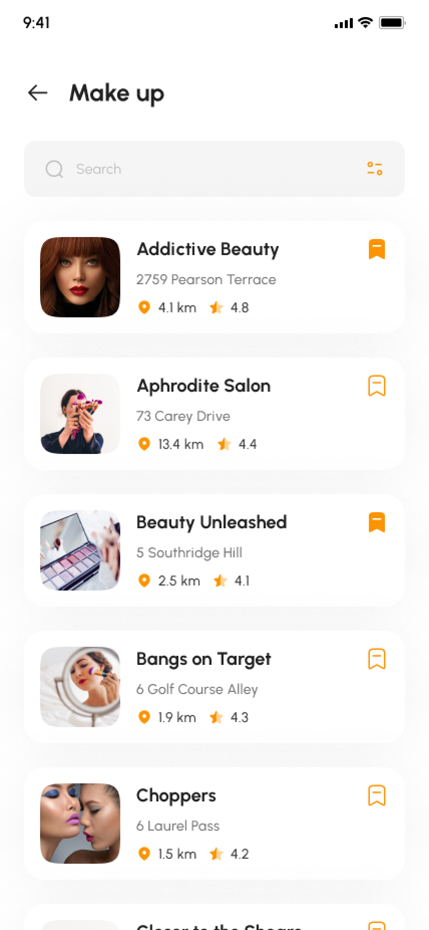
Services section
UI DESIGN OF MOBILE APPLICATION

Slide 16
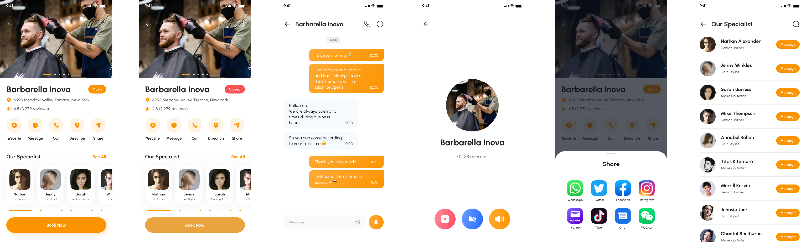
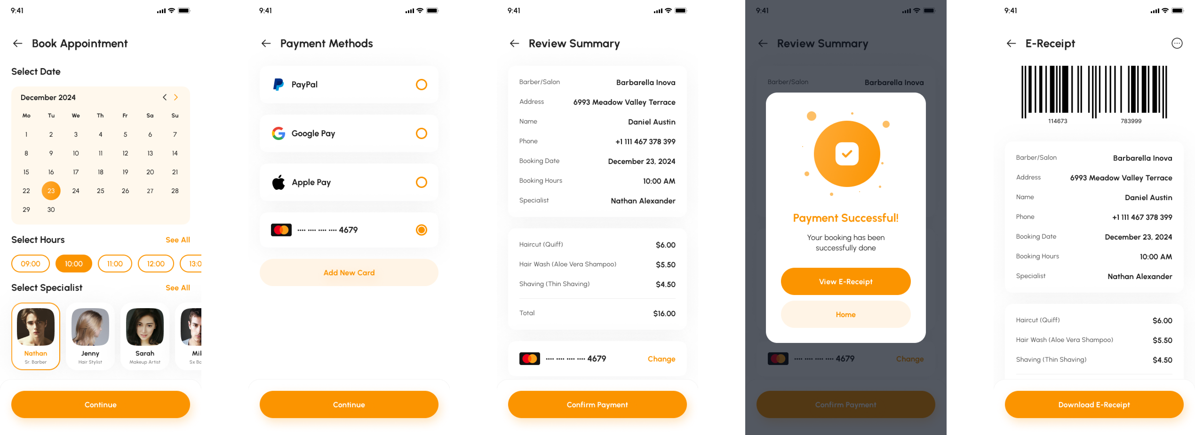
Booking System

Slide 17
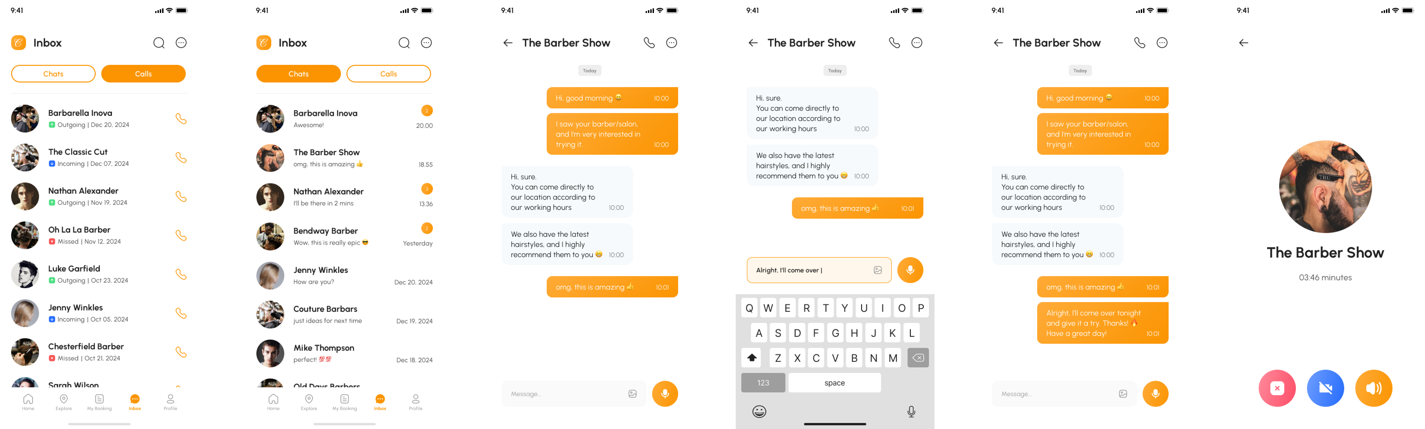
UI DESIGN OF MOBILE APPLICATION
Inbox/ messaging System

Slide 18
Findings and Challenges
Project findings:
1. Booking Options
2. Check availability
3. Price of services
4. Provide services
5. Feedback from the customers

Slide 19
Challenges
Setting clear goals and objectives
Lack of communication
Mismatched team skills
Poor risk management

Slide 20
Conclusion
This system will help saloons to cast their business underneath their space to expand their everyday business. This project also helps local vendors to show their presence globally on the internet and serve their customers with their art. In the salon and beauty industry, the Online Reservation System is suitable for use to reduce customer waiting time and experience a hassle-free environment.

Slide 21
Future Enhancements
Future Enhancements
Future Enhancements
Create attractive separate web sites for each branches using data collect in current version.
Improve appointment booking using mobile app
Enhance the features of the system

Slide 22

Thanks FOR BEING WITH US

Slide 23

ANY QUERY ?

